Slide 1

Stylization-Based Architecture for Fast Deep Exemplar Colorization
Zhongyou Xu, Tingting Wang, Faming Fang, Yun Sheng, Guixu Zhang

Slide 2
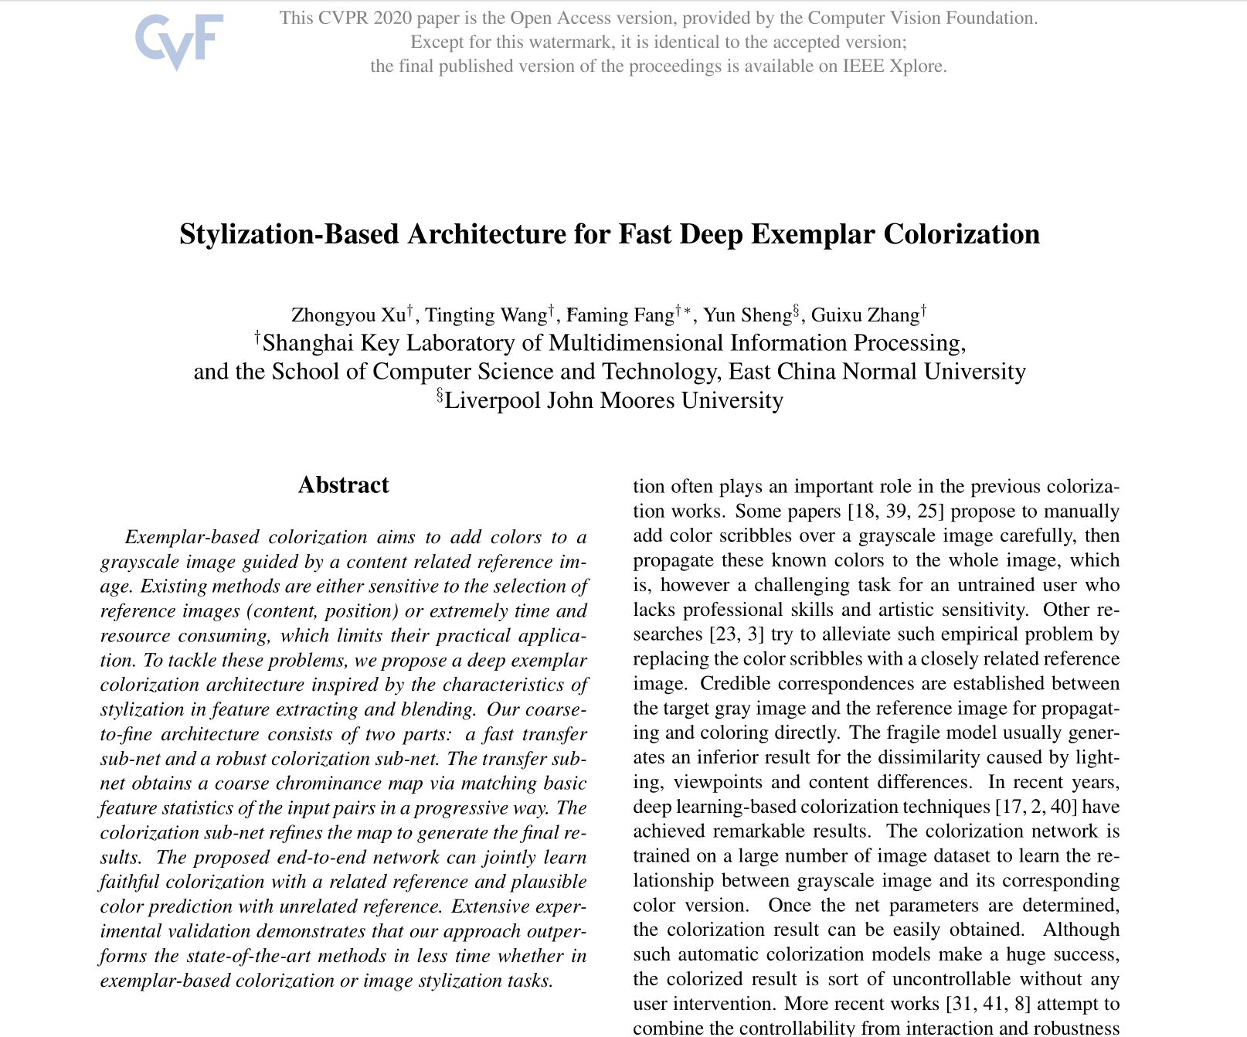

Slide 3
Introduction
Manually add color scribbles over a grayscale image, then propagate to the whole image
A challenging task for an untrained user who lacks professional skills and artistic sensitivity
Replacing the color scribbles with a closely related reference image
Lighting, viewpoints and content differences affect the result.
Automatic colorization by neural network
Uncontrollable without any user intervention
Combine the controllability from interaction and robustness from learning
Colorization is a classic task in computer vision which aims at adding colors to a gray image.

Slide 4
Introduction
The proposed architecture consists of two parts:
Transfer sub-net
Colorization sub-net
Jointly learn faithful colorization with a related reference and plausible color prediction with an unrelated one.
Better colorization in less time compared with other exemplar-based methods
Extend the transfer sub-set to photorealistic image stylization without any additional modification.
A novel deep learning approach for fast exemplar-based colorization

Slide 5
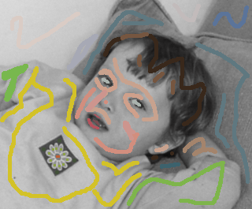
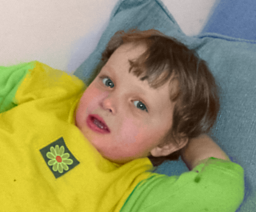
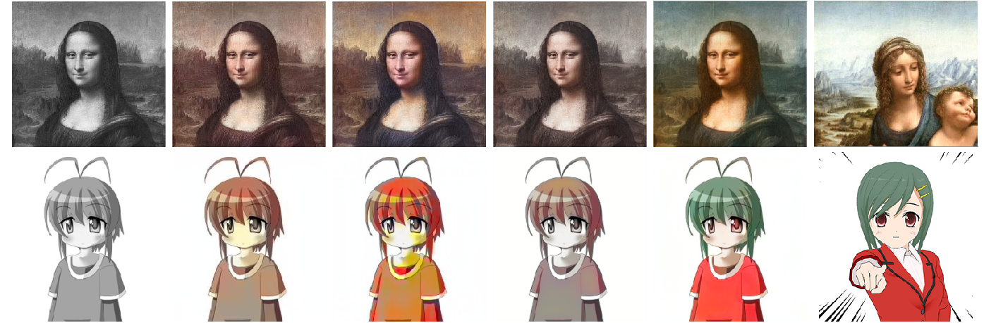
Related Work
Scribble-based colorization
Manually add color scribbles over a grayscale image, then propagate to the whole image
A challenging task for an untrained user who lacks professional skills and artistic sensitivity
Exemplar-based colorization
Colorize a gray image guided by a reference one.
Colorization

Slide 6
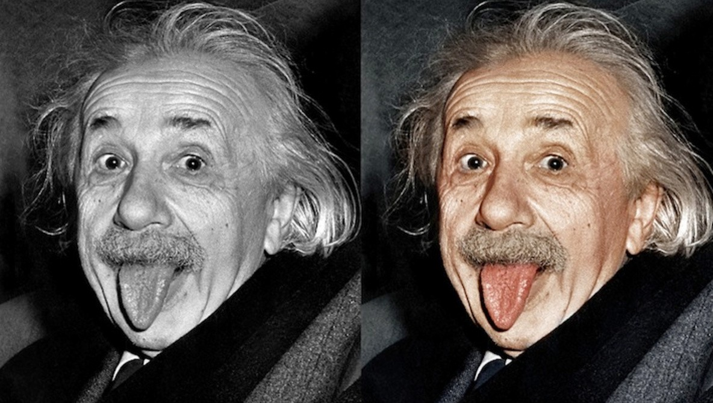
Related Work
Learning-based colorization
Automatic colorization by training an end-to-end network to reconstruct an image by predicting every pixel of the target image.
Only produce a single plausible result for each grayscale image.
Uncontrollable without any user interaction
Hybrid colorization
Combine the controllability from interaction and robustness from learning to achieve more promising colorization.
Colorization

Slide 7
Related Work
Photorealistic image stylization is evolved from traditional style transfer
The most discrepancy is that the output of the former should still maintain the original edge structure clearly.
DSPT adds a regularization term to the loss function of the neural style algorithm to suppress distortions appearing in stylization results.
Li et al. present a modified Whitening and Coloring Transforms (PhotoWCT) model that utilizes unpooling layers and additional smooth operations
Poor robustness and cause artifacts and blurriness
We propose a transfer sub-net which can not only applied to image stylization but also generate an appropriate chrominance map for gray input.
Photorealistic image stylization

Slide 8
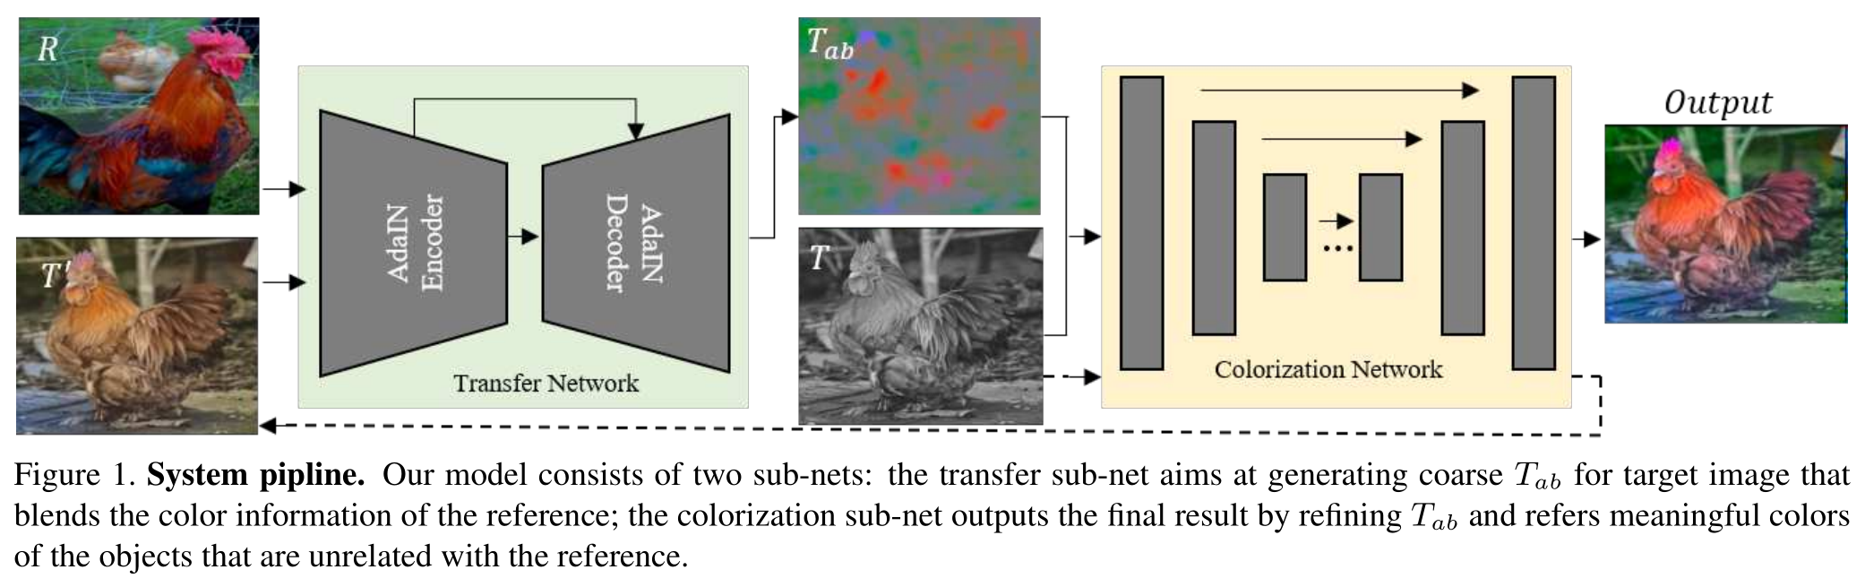
Stylization-based Colorization

Slide 9
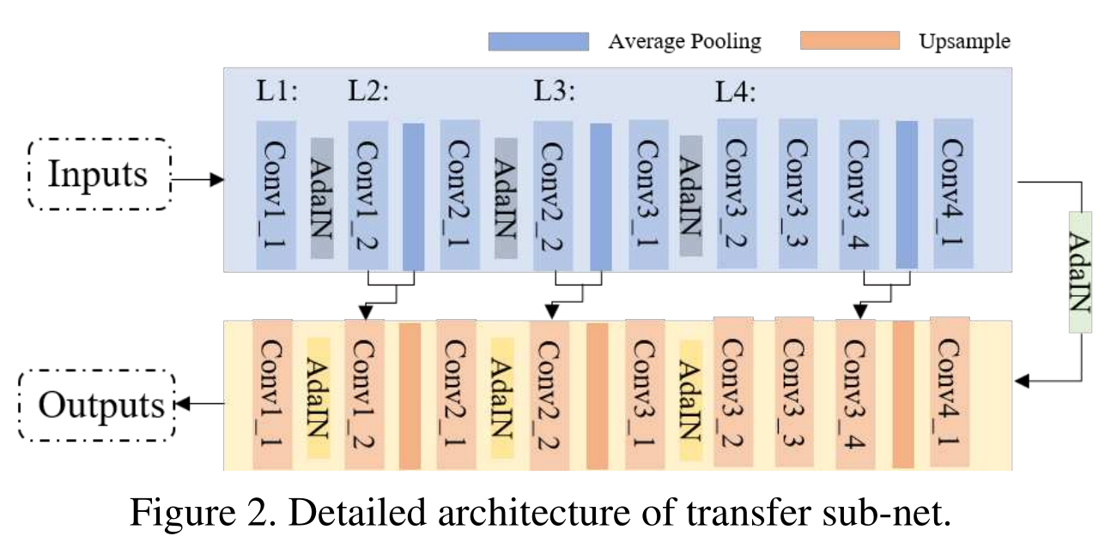
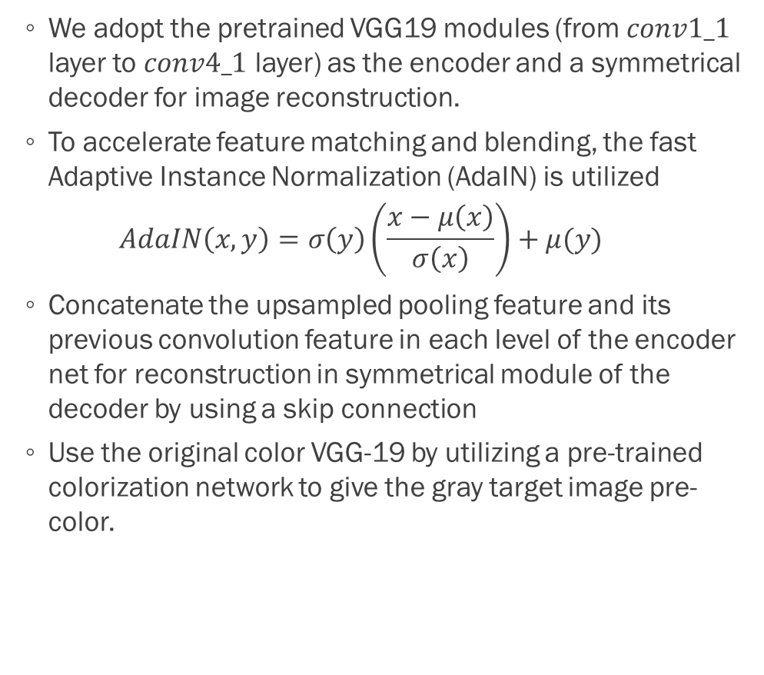
Stylization-based Colorization
We adopt the pretrained VGG19 modules (from $conv1_1$ layer to $conv4_1$ layer) as the encoder and a symmetrical decoder for image reconstruction.
To accelerate feature matching and blending, the fast Adaptive Instance Normalization (AdaIN) is utilized
$$AdaIN\left(x,y\right)=σ\left(y\right)\left(\frac{x−μ\left(x\right)}{σ\left(x\right)}\right)+μ(y)$$
Concatenate the upsampled pooling feature and its previous convolution feature in each level of the encoder net for reconstruction in symmetrical module of the decoder by using a skip connection
Use the original color VGG-19 by utilizing a pre-trained colorization network to give the gray target image pre-color.
Transfer sub-net

Slide 10
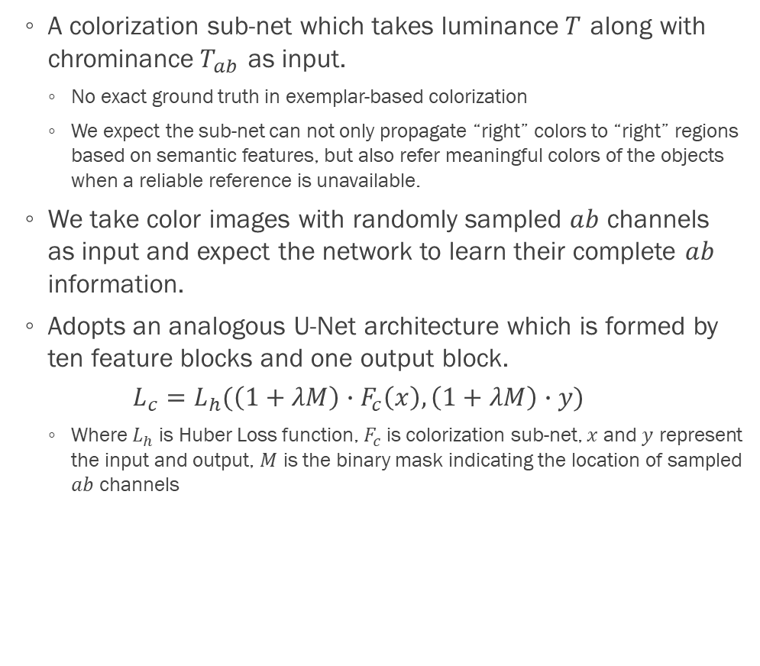
Stylization-based Colorization
A colorization sub-net which takes luminance$T$ along with chrominance$T_{ab}$ as input.
No exact ground truth in exemplar-based colorization
We expect the sub-net can not only propagate “right” colors to “right” regions based on semantic features, but also refer meaningful colors of the objects when a reliable reference is unavailable.
We take color images with randomly sampled $ab$ channels as input and expect the network to learn their complete $ab$ information.
Adopts an analogous U-Net architecture which is formed by ten feature blocks and one output block.
$$L_{c}=L_{h}(\left(1+λM\right)∙F_{c}\left(x\right),\left(1+λM\right)∙y)$$
Where $L_{h}$ is Huber Loss function, $F_{c}$ is colorization sub-net, $x$ and $y$ represent the input and output, $M$ is the binary mask indicating the location of sampled $ab$ channels
Colorization sub-net

Slide 11
Experiments
The decoder of transfer sub-net is trained on the Microsoft COCO dataset
minimizing the sum of the L2 reconstruction loss with weight 0.8
perceptual loss with weight 0.2
the learning rate of which is initially set to 0.0001 and then decreased by a factor of 2 every 5 epochs
The colorization sub-net is trained on the ImageNet dataset
weight coefficient is 10
ADAM optimizer
the learning rate of which is set to 0.00001 and then decreased by 10 after 10 epoch
Implementation details

Slide 12
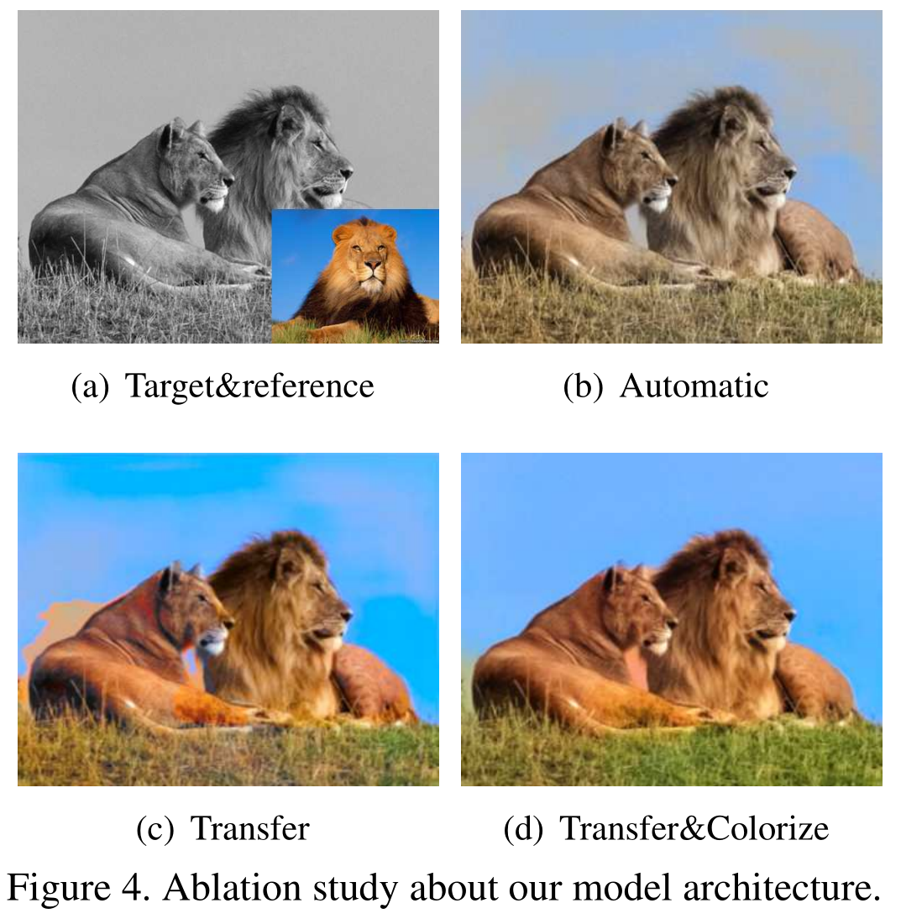
Experiments
First, we feed the target image with an empty ab map to the coloration sub-net and obtain the pre-colorized result in Fig. 4(b). Then, we feed the pre-colorized target image along with the reference to the transfer sub-net and show coarse colorization result in Fig. 4(c).
Ablation study

Slide 13
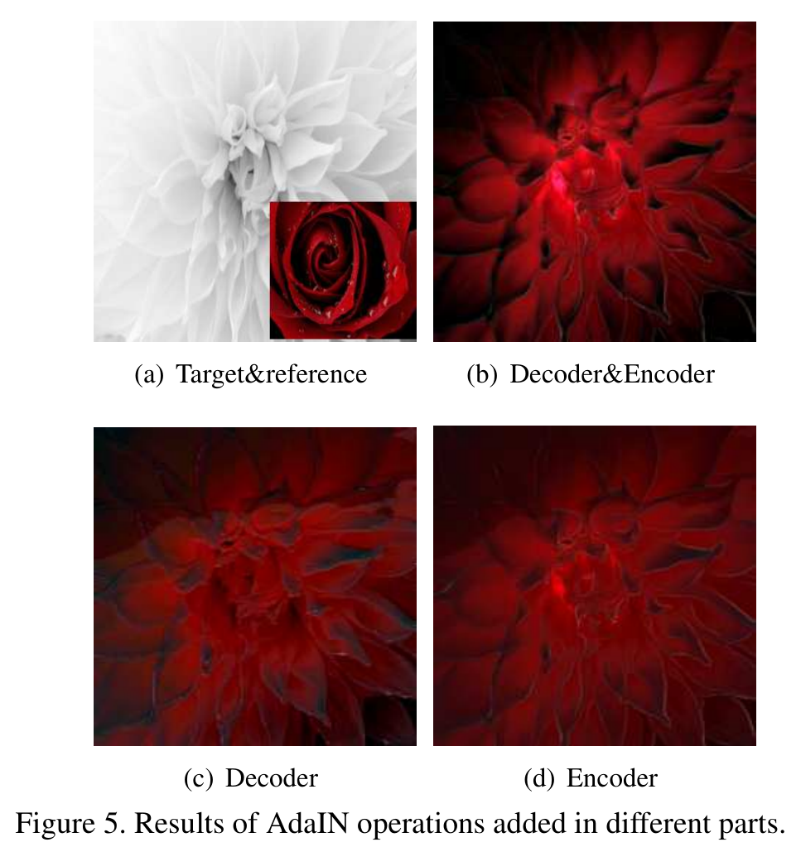
Experiments
Ablation study

Slide 14
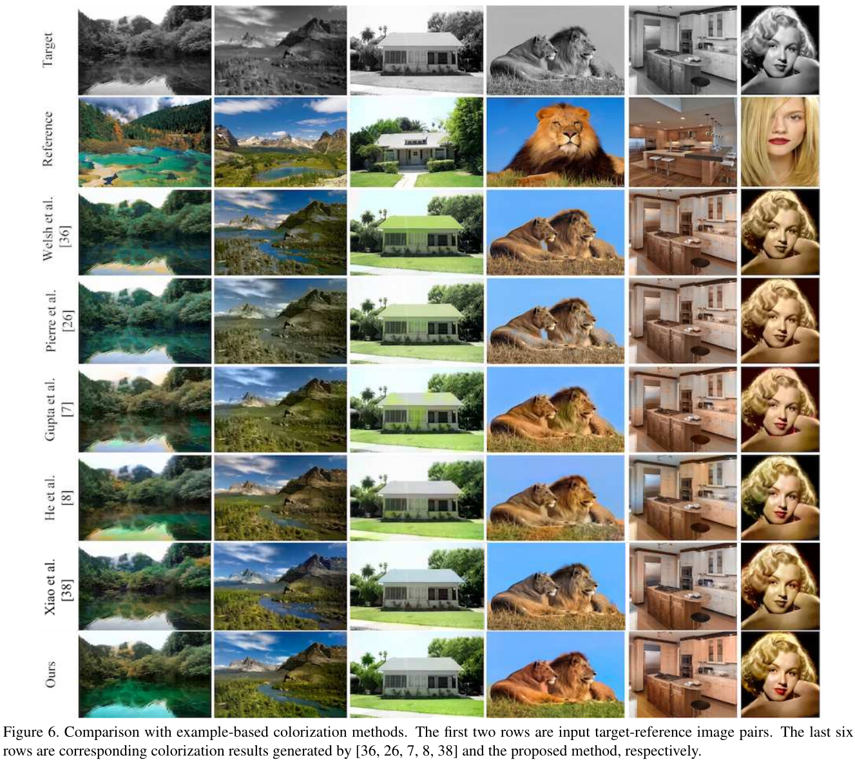
Experiments
Comparison with colorization methods
Visual comparison

Slide 15
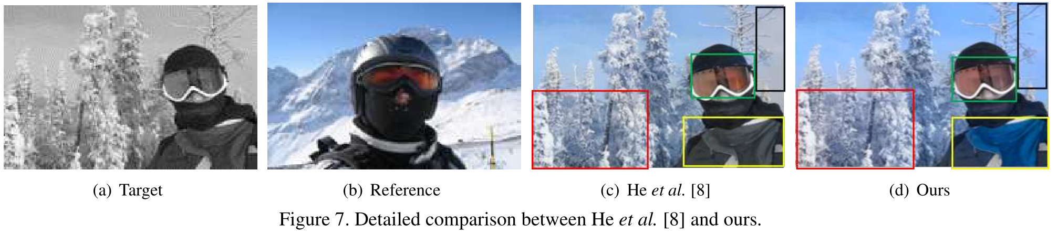
Experiments
Comparison with colorization methods
Visual comparison

Slide 16
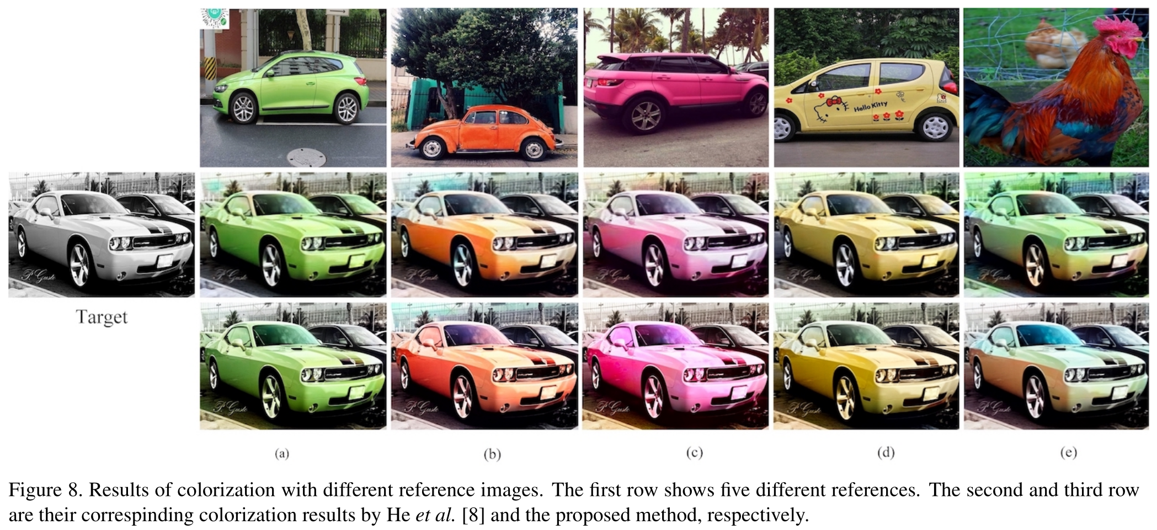
Experiments
Comparison with colorization methods
Visual comparison

Slide 17
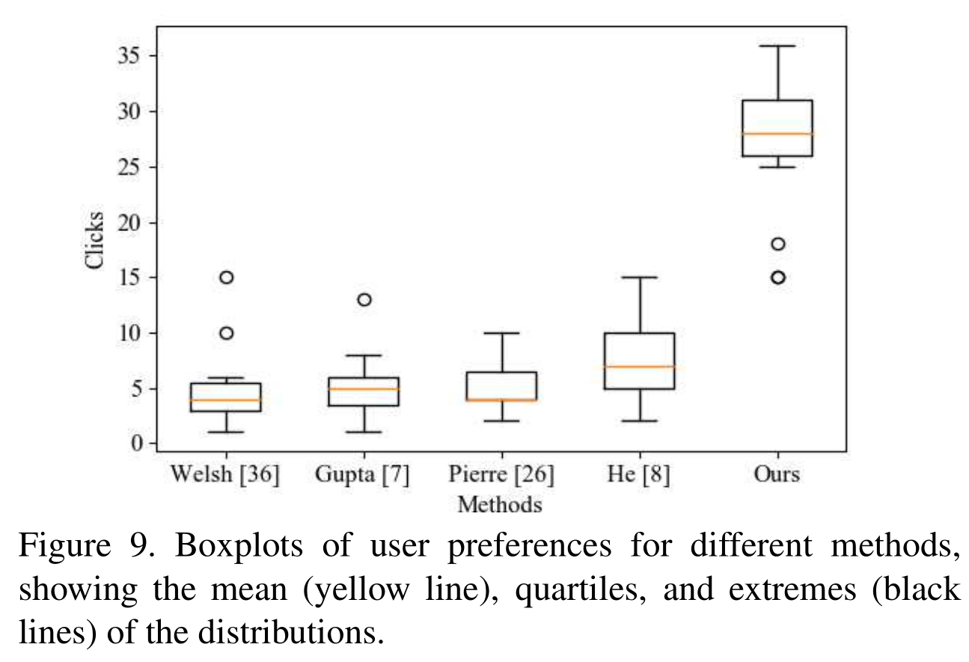
Experiments
Comparison with colorization methods
User evaluation

Slide 18
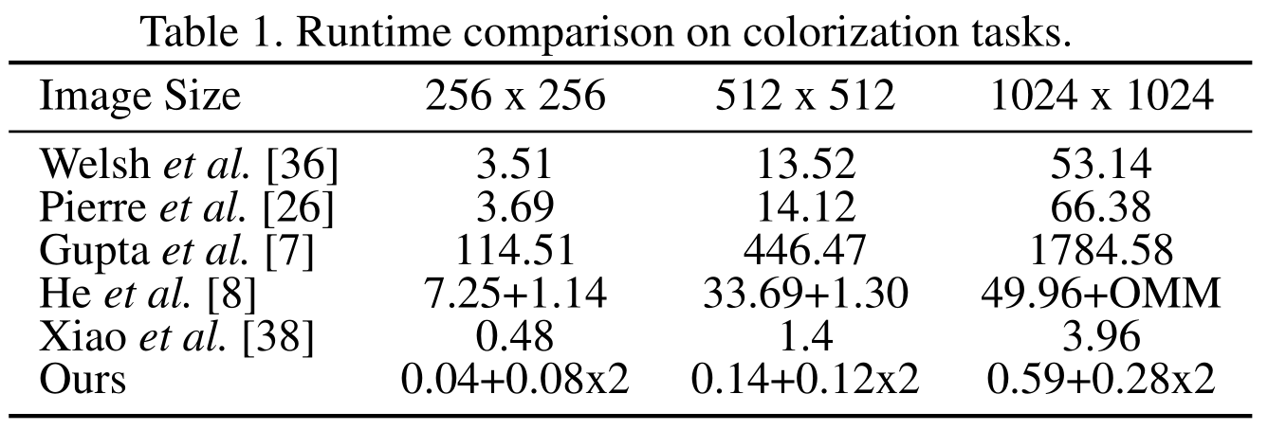
Experiments
Comparison with colorization methods
Runtime comparison

Slide 19
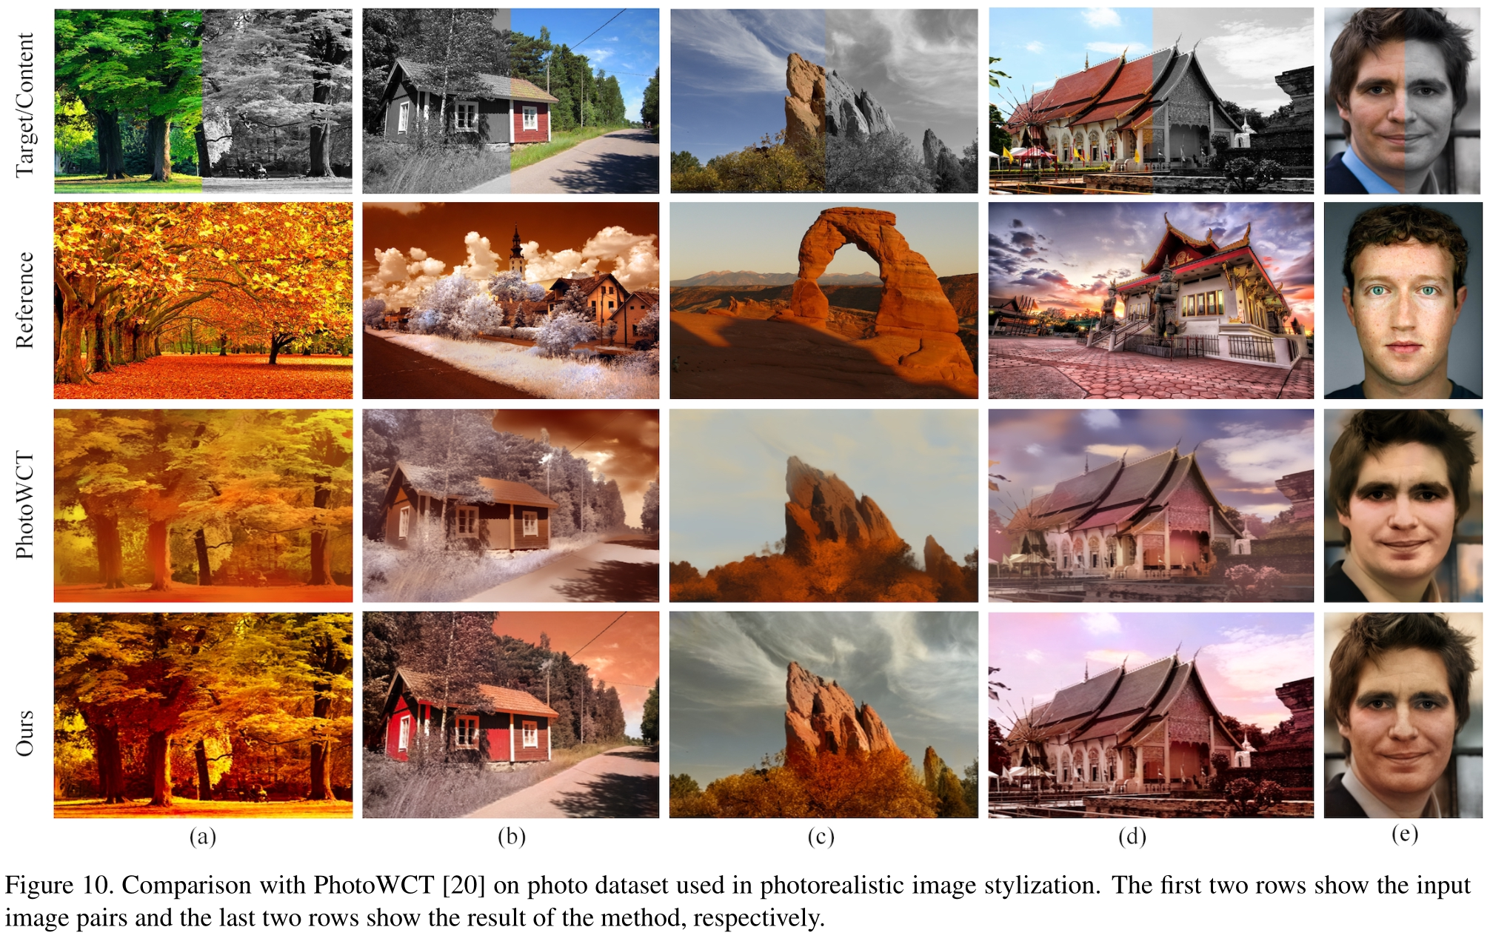
Experiments
Comparison with Photorealistic Image Stylization Methods

Slide 20
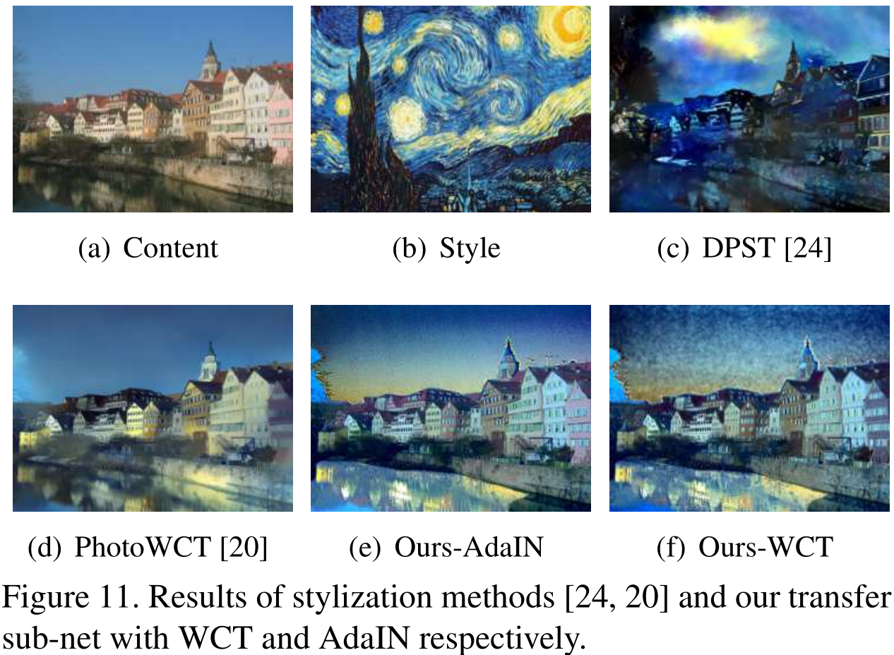
Experiments
Comparison with Stylization Methods

